Slide 1
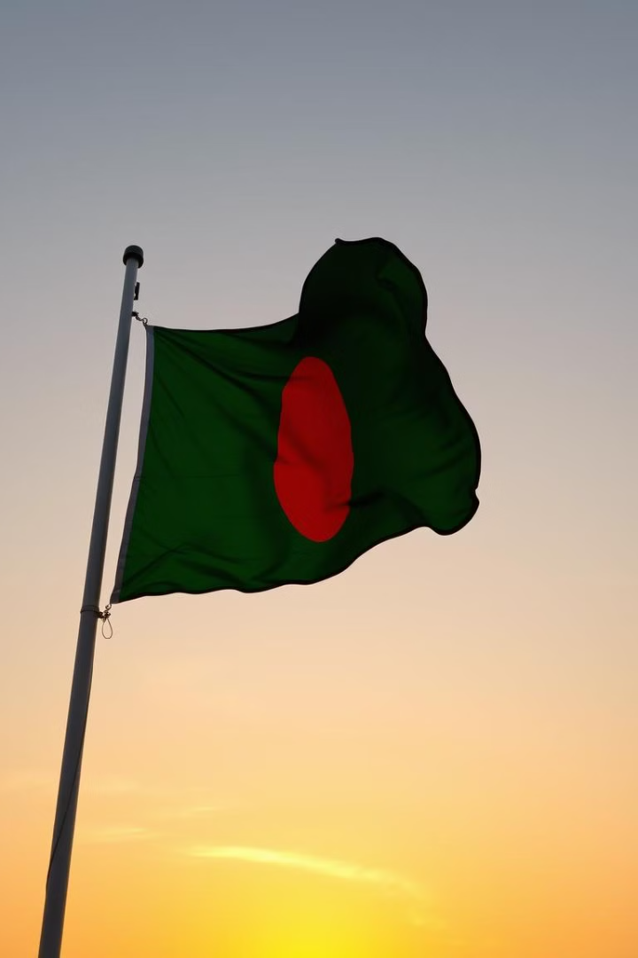

The Rising Crime Rate in Bangladesh
by Emon s

Slide 2
The Rising Wave of Criminal Activities in Bangladesh
A Threat to Safety
Stability and National Progress
GDP grew by 6% in 2023.
The crisis demands attention.
Violent crime surged by 40%.
Uncover the root causes.

Slide 3

Innocent Lives Caught in the Crossfire
1
Rahim (25)
2
Mitu (22)
Killed in a political clash; no arrests.
Assault survivor; struggles with trauma.
3
Jamal
Business owner murdered for refusing extortion.

Slide 4
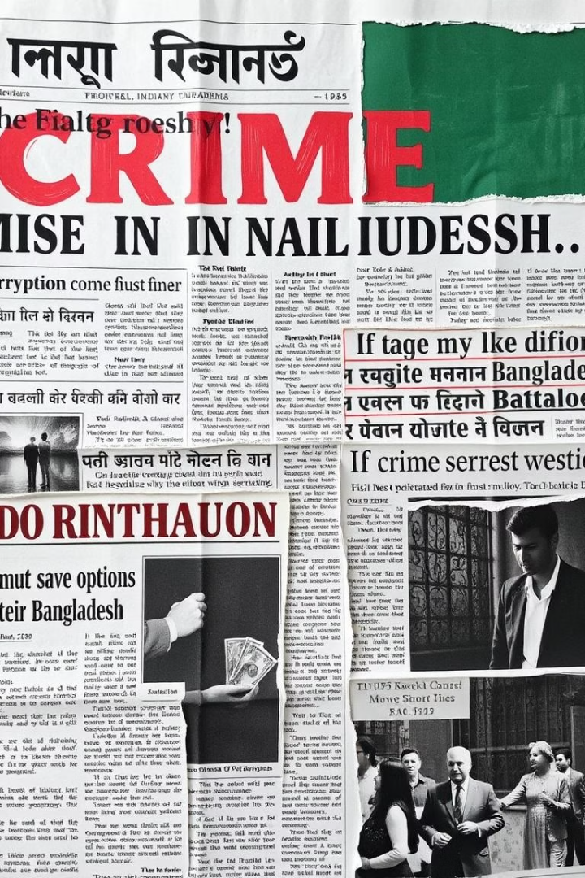



Crime Confirmed: What Experts Say
UNODC
Amnesty
Police Report
"Bangladesh is a key node in Asia’s drug trade."
"Authorities fail to protect women and minorities."
20% rise in violent crimes.

Slide 5
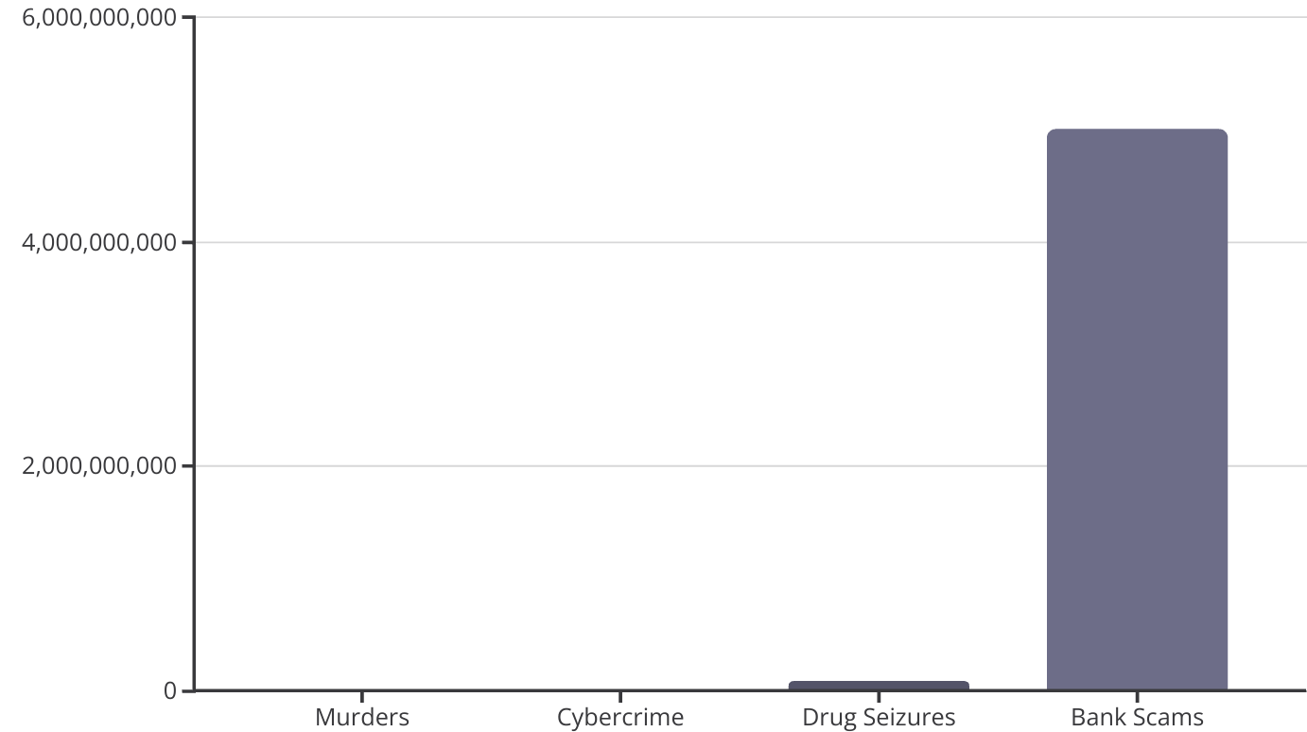
The Numbers Don’t Lie
Statistics show the tragic rise in murders and cybercrime.

Slide 6
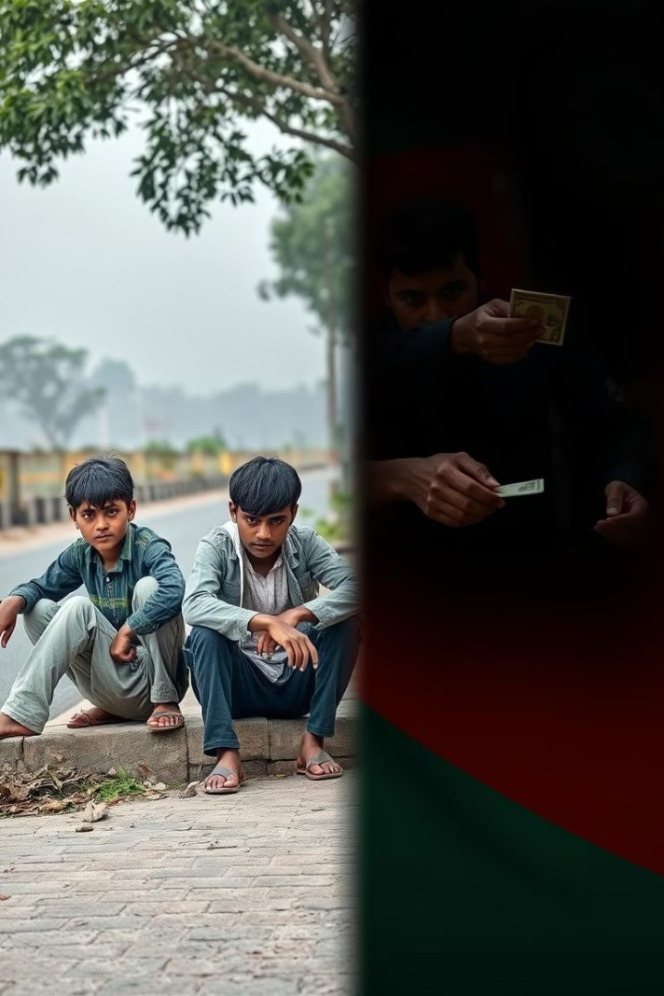
Why Is Crime Rising? A Balanced View
Youth Unemployment
11.2% (World Bank).
Corruption
Distrust in law enforcement.
Urbanization
Increasing disparity.
Low Conviction Rate
Only 7% conviction rate.

Slide 7




Crime vs. Progress: A Nation in Conflict
GDP Growth
Crime outpaces progress.
Economic Loss
৳15,000 crore lost.
Unemployment
Linked to 1 in 3 crimes.

Slide 8

A Crossroads: What Future Do We Choose?
Lives Shattered
1
Every 3 hours.
2
Economic Toll
4% of GDP annually.
UN Warning
3
Risks losing SDG progress.
4
Call to Action
Stronger policies, accountability.

Slide 9
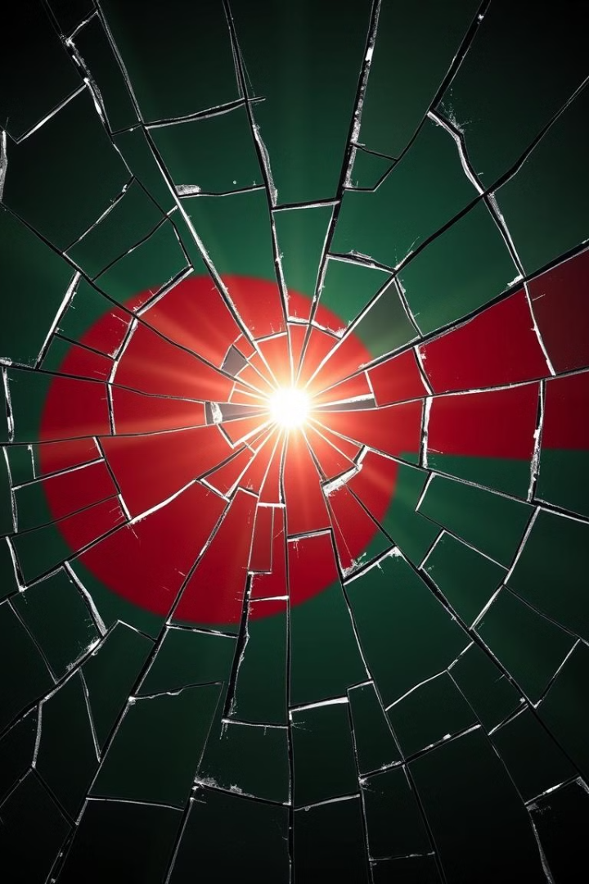
Thank You.
The time to act is now.

